Slide 1
Council On Compulsive Gambling: Comprehensive Market Presentation
Merissa Gilic, Shawna Tonner, Tatianna Ayoub, Michael Mauguin, Robert Callahan, Olivia Gleason & Eric Germain

Slide 2
Executive Summary
Business Issue: What are the gambling patterns of undergraduate students in New Jersey? How can Council on Compulsive Gambling of New Jersey expand its services to best assist these students?
Methodology: Conducted 23 TDI's on undergraduate students in Greek Life in New Jersey and distributed 330 5 – minute surveys.
Key Findings:
Out of 330, 241 of our respondents were freshmen who gamble.
Sports betting and Lottery tickets are the most frequent form of gambling.
More than half our respondents 56% of our respondents gamble daily.

Slide 3
Business Issue and Research Objectives
Key Business Issue: How prevalent is gambling and what gambling challenges exist for Greek-involved college students in New Jersey, and what can the Council on Compulsive Gambling of NJ do to address these issues?
Objective: Identify the frequency of gambling and gambling habits by New Jersey college students in Greek Life.
Objective: Understand the most common forms of gambling, and what influences their decision to gamble
Objective: Identify how the Council on Compulsive Gambling can provide resources to improve education, awareness, and treatment services if necessary.

Slide 4
Methodology
Deliverable 1- TDI's
Deliverable 2- Qualtrics Survey
330 responses
Our Respondents: College students involved in Greek Life who gamble
Conducted 23 TDI's of college students in Greek Life who gamble

Slide 5
Phase 1 Recap (TDIs)
Main Goal
Aimed towards understanding common forms of gambling and the habits correlated through qualitative insight
Key Findings Based on TDIs
More men gambled than women
Just above half of those interviewed gambled less than $100 per week
The need for money in addition to winning was a reoccurring influence to continue
Almost all felt that gambling was not an issue
All but one did not feel the need for help or resources

Slide 6
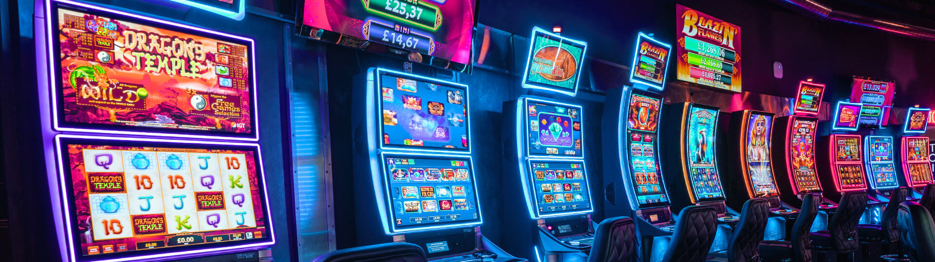
Phase 2 Recap (Online Survey)
Key Findings Based on Qualtrics Survey
More women gambled than men
College students are influenced most by their friends followed by their family and Greek organization
An overwhelming percentage of college student gambled more than $100 in a day, every day
Losing while gambling is just as encouraging as winning when deciding to gamble again
Most of our respondents have considered stopping, while less than half would utilize resources for help
Main Goal
To gain a deeper understanding of the influences of gambling and the relationship students share with gambling through quantitative insights.

Slide 7
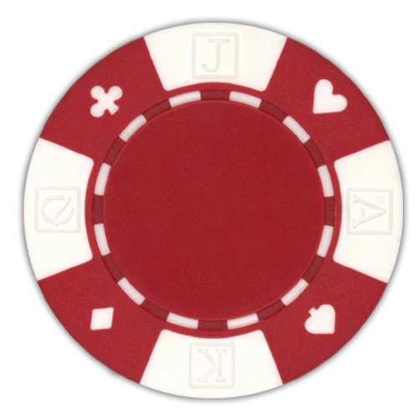
23 TDI'S
Gamblers Chart
School | Men | Women | Total
Seton Hall University | 12 | 3 | 15
Montclair University | 2 | 1 | 3
Rutgers University | 1 | 3 | 4
Kean University | 1 | 0 | 1
Total | 16 | 7 | 23
Out of 330 Surveys
School | Men | Women | Non-Binary/Third Gender | Total
Seton Hall University | 20 | 3 | 2 | 25
Montclair University | 6 | 2 | 0 | 8
Rutgers University | 9 | 11 | 0 | 20
Kean University | 3 | 5 | 0 | 8
Total | 38 | 21 | 2 | 61

Slide 8
Likelihood to return to gambling
304 out of our 330 student responses are likely to gamble again within the next 30 days (92%)
Only 8% of students were not likely to gamble again in next 30 days

Slide 9
How Often is Too Often?
65% gamble on a daily basis
26% gamble 2-3 times per week
2% gamble once per week
3% gamble once per month
2% gamble 1-3 times per year
Of the 330 respondents:

Slide 10
How Do They Gamble?
Sports Betting- 19%
Lotter Tickets- 19%
Day Trading- 14%
Casinos- 17%
Poker Nights- 15%
Online Casino Games- 17%
Considering that this was a question where you can submit multiple responses, many of our respondents
gamble in more than one way. Nobody really sticks to just one form of gambling. As you can see above, the
numbers hit pretty close.

Slide 11
WHO GAMBLES THE MOST?
Of all the age groups interviewed, freshman – senior college undergrads, Freshman gamble the most.
Of 324 respondents, 241 were freshman.
74%

Slide 12
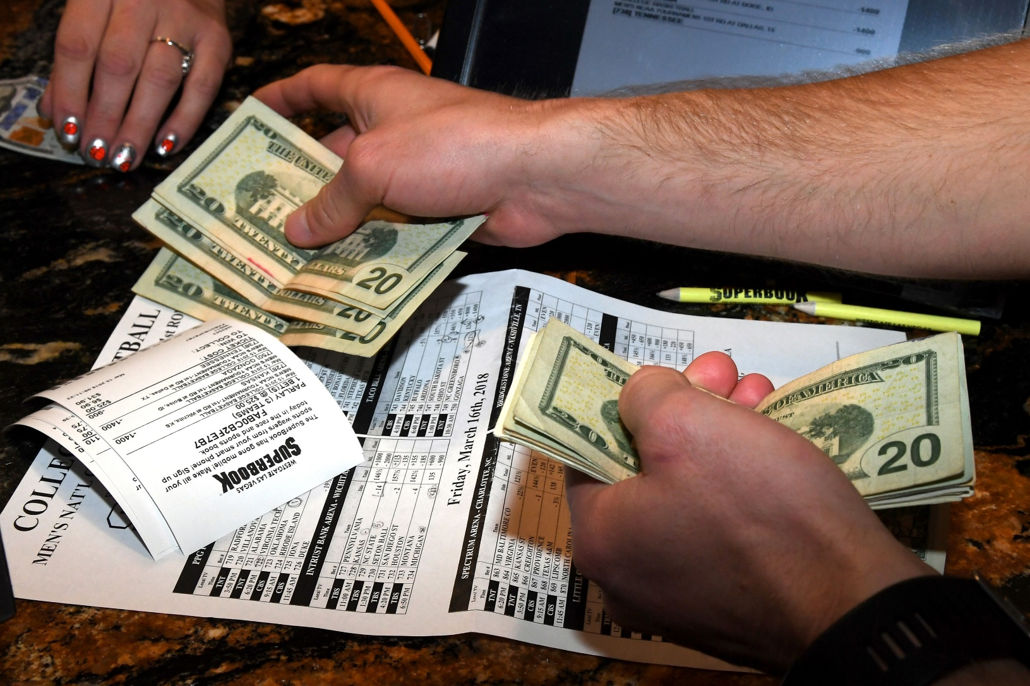
Wager Amount Per Day
Out of $100, top 5 amounts per day are:
1. $100 (40 people)
2. $95 (21 people)
3. $99 (12 people)
4. $83 (11 people)
5. $96 (10 people)
- Based on the data provided, 29% of the respondents wager more than $80.
- Key Takeaway: Many respondents bet multiple times a day and are wagering lots of money a day for college students which can affect them in the future.

Slide 13
Relationships With Gambling
On a scale of 1-10, 1 being a bad relationship and 10 being the best relationship, the most frequent answer was a 10 out of 10 from the respondents
Less than 1% of the respondents answered within the 1-5 range.
Based on the results, the respondents have the best relationship with gambling and do not think of it as a problem. This means that either the respondents are winning their bets and having fun, or they haven’t realized the negative impact that gambling has had on them.

Slide 14
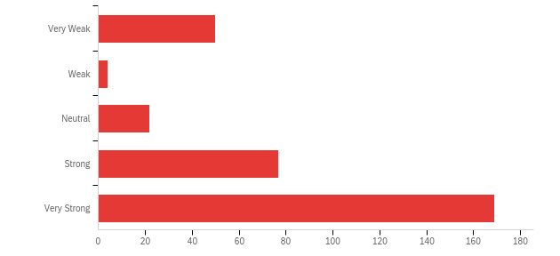
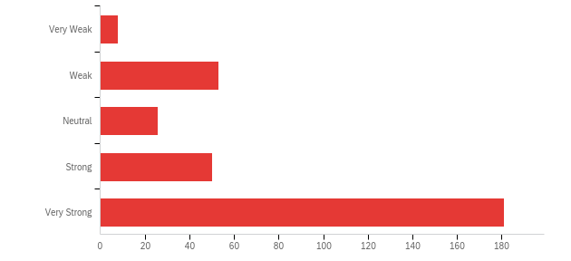
Urges After Wins or Losses
Urge to Continue after Wins
Out of 322 respondents, 169 have a very strong urge to continue to gamble while on the contrary, 50 have a very weak urge to bet again
# of Participants
Out of 318 respondents, 181 have a very strong urge to win their lost money back while only 8 are okay with losing with losing the money.
Urge to Continue after Loss
# of Participants

Slide 15
How likely would you be to utilize resources to manage your gambling habits?
2
3
4
5
6
7
Extremely Unlikely
Extremely Likely
2%
2%
4%
14%
34%
44%
Respondents reported that they would be very likely to utilize resources to manage their gambling habits. This data differs from the responses we got in our TDIs. ​

Slide 16
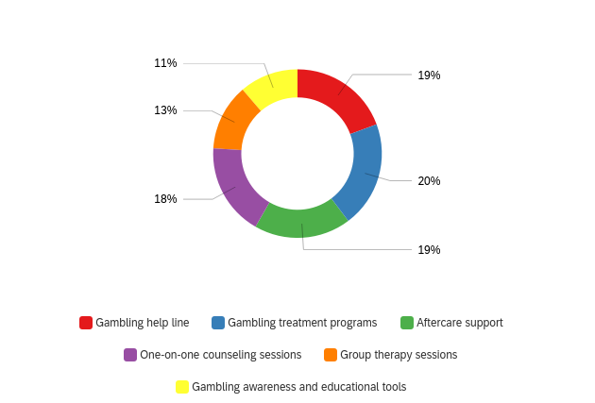
Preferred Resources
Resources Preferred
Responses showed that the resources listed were almost all equally likely to be the most preferred method of help that would be considered
From this we can gather that preferred methods of help truly depends on the person and their specific relationship with gambling

Slide 17
Everyone Wants to Fold
“The reward is worth the risk of losing”
“I don’t have a gambling problem”
95%
“Have you ever wanted to stop gambling completely?”
Yes
65%
No
35%

Slide 18
Conclusions & Recommendations
•Have people from the Council present in offices on campuses throughout New Jersey
Host meetings that can allow people to talk about their habits
Hand out flyers for other services that students could use
-Colleges in New Jersey can have flyers hung up on campus with 1-800 GAMBLER hotline
Tour of campus to show the flyers around to all new students

Slide 19
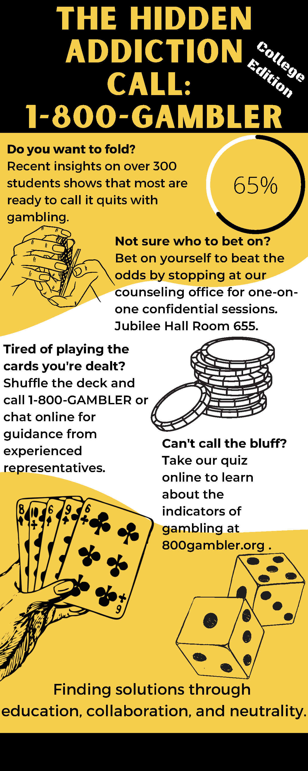

Slide 20
APPENDIX
Are you currently a college undergraduate student in New Jersey?
In the past twelve months, which of the following activities have you participated in? Please select all that apply.
What college do you attend in New Jersey?
What kind of activities are you part of on campus? Please select all that apply.
What year of schooling are you currently in?
What is your gender?
Please select which of the following factors have the most influence on your gambling activities.
Reviewing the list below, please select the option that best estimates how often you participate in any gambling related activities?
Over the last 7 days, please estimate how many days you have participated in some sort of gambling related activity?
How likely do you anticipate that you will gamble again in the next 30 days? (0= Very unlikely, 7= Highly likely)
When you participate in gambling, please estimate how much is your typical amount of wagering in a day.
Each person has a different relationship with gambling. Every relationship varies based on your gambling experience and habits. On a scale from 1 to 10, please rate your relationship with gambling. (1 = negative relationship, 10 = positive relationship).
Based on your answer in the previous question, briefly state why you chose that answer.
After you win, how strong is your urge to return and win more?
After you lose, how strong is your urge to recoup what you lost?
Have you ever wanted to stop gambling completely?
In a sentence or 2, describe your biggest challenge to stop participating in gambling-related activities?
If available to you, how likely would you be to utilize resources to manage your gambling habits? (1= extremely unlikely, 7 = extremely likely).
Which resources would you find most helpful in managing your gambling habits? (Please select all that apply.)
Which are the best ways to initially learn about gambling related support resources that you would most benefit from? Please select all that apply.

